Slide 1

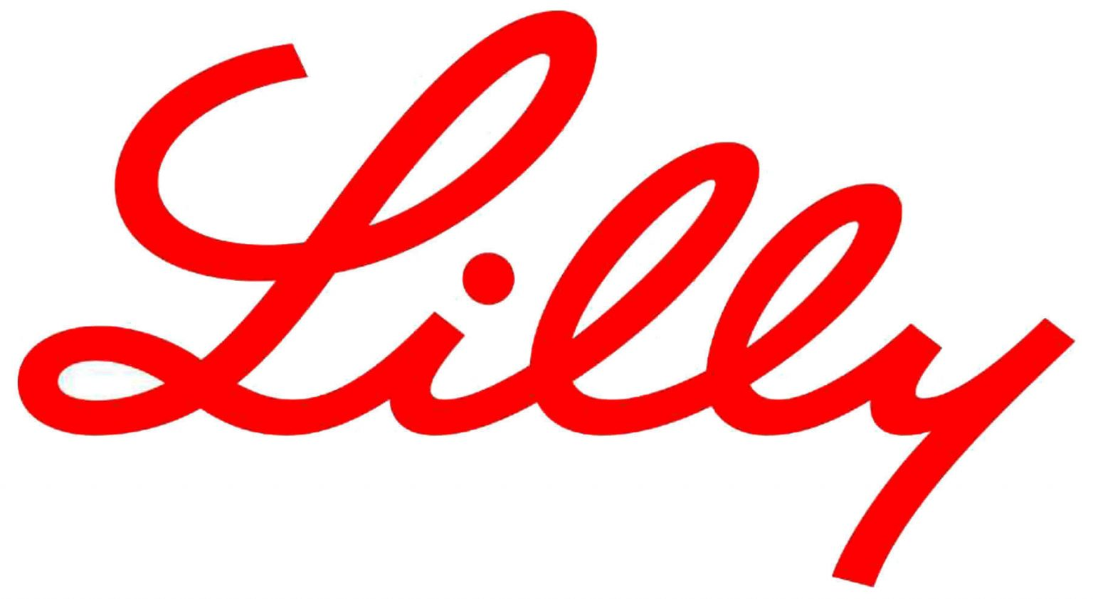
ELI LILLY AND COMPANY
BEYOND CAPITAL
Ayushi Kedia
Shama Mody
Siddhesh Shelke
Kartik Sharma

Slide 2
ABOUT THE COMPANY
Medicine is a science of uncertainty and an art of probability. – William Osler
Founded by Colonel Eli Lilly in the year 1901 in Indianapolis, Eli Lilly and Company (Lilly) is one of the leading pharmaceutical companies in the United States of America
Lilly offers its products to pharmacies, hospitals, physicians and other healthcare professionals
The company’s products are sold across the country and Lilly has a global presence in over 110+ countries
Lilly’s purpose is to unite caring with discovery to create medicines that make life better for people around the world with products that are discovered by Lilly's own in-house scientists

Slide 3
Ticker | LLY (NYSE)
CMP | $ 450
Market Capitalization | $ 430 B
52 Week Range | $ 296 – $ 457
Headquarters | United States of America
Website | www.lilly.com
Telephone | +1 (317) 276-2000

Slide 4
PRODUCTS AND SERVICES
DIABETES PRODUCTS
ONCOLOGY PRODUCTS
IMMUNOLOGY PRODUCTS
NEUROSCIENCE PRODUCTS
OTHER PRODUCTS AND THERAPIES
Basaglar
Humalog
Humulin
Jardiance
Mounjaro
Trulicity
Alimta
Cyramza
Erbitux
Jaypirca
Retevmo
Tyvyt
Verzenio
Olumiant
Taltz
Cymbalta
Emgality
Zyprexa
Bamlanivimab
Eyesevimab
Bebtelovimab
Cialis
Forteo

Slide 5
FINANCIAL PERFORMANCE AT A GLANCE

Slide 6
Particulars (In US$ Millions) | FY2017 | FY2018 | FY2019 | FY2020 | FY2021 | FY2022 | Q1FY2022 | Q1FY2023
Topline | 22,871 | 21,493 | 22,320 | 24,540 | 28,318 | 28,541 | 7,810 | 6,960
EBITDA | 6,293 | 7,420 | 7,164 | 8,174 | 9,390 | 9,803 | 3,006 | 1,961
Profit Before Tax | 2,197 | 3,680 | 5,266 | 7,230 | 6,156 | 6,806 | 2,054 | 1,530
Net Income | -204 | 3,151 | 4,638 | 6,194 | 5,582 | 6,245 | 1,903 | 1,345
EPS | -0.19 | 3.14 | 8.93 | 6.82 | 6.15 | 9.63 | 2.11 | 1.49
Equity Share Capital | 6,506 | 8,245 | 7,284 | 7,377 | 7,430 | 7,516 | 7,250 | 7,387
Total Debt | 13,647 | 10,299 | 15,317 | 16,595 | 16,885 | 16,239 | 16,509 | 18,884
Cash & Cash Equivalents | 8,034 | 7,409 | 2,439 | 3,681 | 3,909 | 2,212 | 2,568 | 3,669
Free Cash Flow | 4,539 | 4,314 | 3,803 | 5,112 | 5,951 | 5,230 | 2,158 | 1,062

Slide 7
Particulars | FY2017 | FY2018 | FY2019 | FY2020 | FY2021 | FY2022 | Q1FY2022 | Q1FY2023
Key Ratios and Multiples:
EBITDA Margin | 15.15% | 23.93% | 27.81% | 30.08% | 27.91% | 30.31% | 36.36% | 26.67%
Operating Margin | 8.29% | 16.44% | 22.29% | 24.69% | 22.45% | 24.97% | 30.78% | 21.47%
Pretax Margin | 9.61% | 17.12% | 23.59% | 29.46% | 21.74% | 23.85% | 26.29% | 21.98%
Net Income Margin | -0.89% | 15.04% | 37.27% | 25.24% | 19.71% | 21.88% | 24.36% | 19.32%
Return on Common Equity | -1.59% | 30.18% | 133.78% | 150.18% | 76.35% | 63.63% | 75.53% | 55.42%
Return on Assets | -0.49% | 7.27% | 20.00% | 14.42% | 11.70% | 12.71% | 13.07% | 11.36%
Total Debt/Equity | 116.96 | 94.40 | 567.49 | 284.89 | 184.44 | 150.70 | 174.47 | 167.19
Cash Ratio | 0.55% | 0.62% | 0.21% | 0.29% | 0.26% | 0.13% | 0.19% | 0.23%
Current Ratio | 1.32% | 1.73% | 1.16% | 1.40% | 1.23% | 1.05% | 1.27% | 1.30%
Quick Ratio | 0.87% | 1.00% | 0.59% | 0.76% | 0.70% | 0.52% | 0.66% | 0.69%
P/E | 22.50x | 23.78x | 22.39x | 22.29x | 35.51x | 48.35x | 33.49x | 47.74x
P/BV | 8.01x | 12.45x | 48.27x | 28.63x | 29.34x | 32.64x | 29.16x | 29.13x
P/S | 3.88x | 5.53x | 5.48x | 6.24x | 8.85x | 11.56x | 8.86x | 11.18x
P/FCF | 19.58x | 27.57x | 32.18x | 29.98x | 42.10 | 63.08x | 38.69x | 74.47x
EV/Sales | 4.31x | 5.88x | 6.22x | 7.12x | 9.77x | 12.68x | 9.76x | 12.33x
EV/EBITDA | 28.46x | 24.55x | 22.37x | 23.65x | 34.99x | 41.82x | 30.97x | 44.52x
EV/EBIT | 51.98x | 35.73x | 27.91x | 28.82x | 43.51x | 50.76x | 37.62x | 54.90x
Enterprise Value | 98,595 | 1,26,290 | 1,38,819 | 1,74,608 | 2,76,570 | 3,61,767 | 2,86,168 | 3,41,316

Slide 8
PEER COMPARISON
Particulars | Lilly | Merck & Co. | Abbvie Inc | Bristol | Pfizer Inc | JNJ | Median
Market Capitalization (In US$ Billions) | 430 | 283 | 240 | 138 | 221 | 426 | 260
Enterprise Value (In US$ Billions) | 445 | 303 | 295 | 168 | 237 | 454 | 300
P/E | 63x | 18x | 14x | 16x | 7x | 19x | 17x
P/FCF | 98x | 25x | 10x | 13x | 11x | 27x | 19x
EV/EBITDA | 53x | 14x | 10x | 8x | 6x | 11x | 10x
Sales Growth | -5.56% | 7.21% | 0.03% | -2.37% | 0.56% | 1.46% | 0.29%
EBITDA Margin | 30.28% | 38.42% | 53.21% | 43.97% | 42.88% | 44.19% | 43.43%
Net Profit Margin | 23.49% | 26.95% | 30.74% | 18.57% | 34.61% | 23.30% | 25.22%
Return on Assets | 13.00% | 14.54% | 12.56% | 8.63% | 16.96% | 11.99% | 12.78%
Return on Equity | 63.38% | 35.56% | 117.74% | 26.85% | 35.09% | 30.82% | 35.32%
Net Debt to Equity | 135.00% | 43.00% | 416.00% | 95.00% | 16.00% | 40.00% | 69.00%

Slide 9
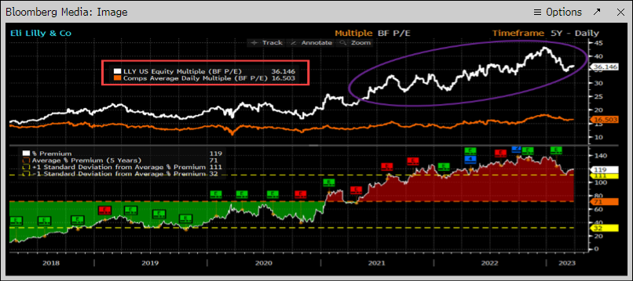
PEER COMPARISON

Slide 10
INDUSTRY OUTLOOK
Potential revolutionary data sets look limited as the regulatory and commercial delivery of expected near term launches dominate and focus on obesity and cancer.
A U.S. Inflation Reduction Act renegotiation looks unlikely although how will IRA cut drug prices remains unclear.
Consensus Cals for a continued easing of dollar strength which was a headwind for many large pharmaceutical companies throughout last year.
Large drug makers can't escape inflationary pressure. As economic stress continues, health care costs could become a greater government focus.
EU countries and Japan cut drug prices every two years except for an off-year in April.
The centers for Medicare and Medicaid Services will release a list of 10 Part D drugs by September that will be subject to government price cuts in the beginning in 2026.

Slide 11
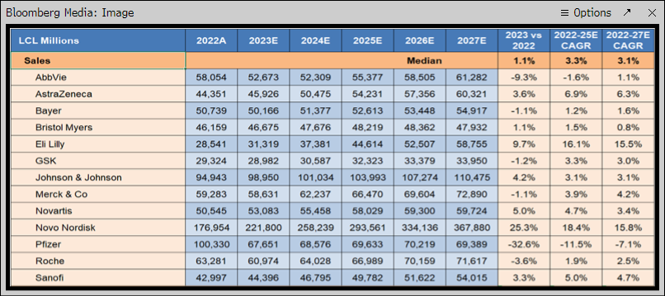
INDUSTRY OUTLOOK

Slide 12
LATEST NEWS
Lilly to pay $2.4 billion for immune drug developer Dice Therapeutics Inc. [oral treatment immune diseases]
FDA approves Eli Lilly and Boehringer Ingelheim’s Jardiance for children 10 and older with type 2 diabetes
Taking on a Disease that can’t be ignored
XtalPi announces $250 M AI drug discovery collaboration with Eli Lilly
Key data on Novo Nordisk’s weight loss drug Wegovy due in July: Biotech analysts details likely impact on Lilly’s stock

Slide 13
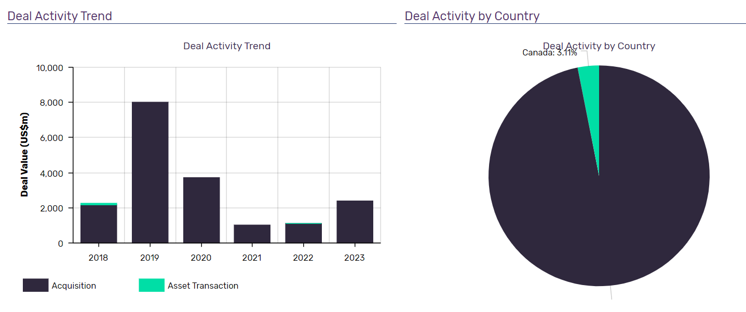
MERGERS & ACQUISITION

Slide 14
MERGERS & ACQUISITION
ANNOUNCED DATE | TARGET | DEAL VALUE (in millions)
20th June 2023 | Dice Therapeutics Inc | $2400
17th Oct 2022 | Akouos Inc. | $1097
14th Jul 2021 | Protomer Technologies Inc. | $1000
15th Dec 2020 | Prevail Therapeutic Inc. | $1040
15th Oct 2020 | Disarm Therapeutic Inc. | $1360

Slide 15
SWOT ANALYSIS
STRENGTHS
Strong focus on R&D
WEAKNESS
Increasing liabilities
OPPORTUNITIES
Strategic agreements
THREATS
Consolidation and integration among healthcare providers and increasing government price controls
Wide geographic presence
Revenue performance
Strategic acquisitions
Positive outlook for global pharmaceutical industry provides growth opportunity for the company
Regulatory compliance problems could have a negative impact on the company
Foreign exchange risks

Slide 16
STRATEGIC OVERVIEW
Lilly's long term success relies on the company's ability to continually discover, develop or acquire and commercialize innovative new medicines.
Delivering strong revenue growth, investing in current portfolio, future innovation and speed life-changing medicine are primary strategic deliverables for Lilly.
Lilly returns Capital to its Shareholders via Dividend (distributed >$1 Billion via dividends in Q1FY2023) and Share Repurchase ($750 Million in Q1FY2023).
Lilly currently has 45 new medicine candidates in clinical development state and under review and a larger number of products are in the discovery phase.
In other matters, Lilly depends on patents and other forms of intellectual property protection for most of their revenue, cash flows and earnings.
Lilly strategically invests in external research and technologies that they believe can take many forms, including collaborations, acquisitions, investments and licensing agreements.
The company views its business development activity as a way to enhance their pipeline and strengthen business.
Lilly has increased R&D expenses by 23%, Marketing Selling and Admin expenses by 12%.
Domestically and abroad, going forward Lilly will continue to monitor the potential impacts of the economic environment, creditworthiness of wholesalers and customers, the uncertain impact of healthcare legislation, various international government funding levels and fluctuations in interest rates, foreign exchange rate and fair values of equity securities.

Slide 17
VALUE DRIVERS
Strategic Acquisitions
Strong focus on Research and Development
Increase global presence
Product Delivery
Strong growth outlook on Mounjaro
Meaningful Pipeline Options which could add billions to post 2027 sales

Slide 18
FREE CASH FLOW

Slide 19
WACC CALCULATION

Slide 20
DIVIDEND DISCOUNT MODEL

Slide 21
ESG
ENVIRONMENTAL
Lilly’s environmental score of 4.64 leads them in biotechnology and pharmaceuticals peers
Only energy and waste management scores are issued for the industry
The company had an improvement of 8.60% year over year in their environmental score
SOCIAL
They even lead the peer board in social scores, they had a social score of 3.67
Product quality management and access & affordability are two highest-weighted issues for the industry
Lilly’s social score had improved 9.11% year over year
GOVERNANCE
Their governance score of 6.67 leads them on the peer board for biotechnology and pharmaceuticals peers
The governance score for this industry comprise of: Board Composition, Executive Compensation, Shareholder Rights and Audit
Lilly’s score was driven because of outperformance of the Executive Compensation theme

Slide 22
CRITICAL ANALYSIS AND RECOMMENDATIONS
Lilly currently has a Market Capitalization of $430 Billion with an Enterprise Value of $445 Billion. Lilly rewards its shareholders with a Return on Equity of >60% which is far superior than its peers which are in the range of 35%.
New Products contributed $573.6 million to revenue in Q1 2023, led by Mounjaro. Growth Products revenue increased 18% to $4.56 billion in Q1 2023, led by Verzenio, Trulicity, Jardiance and Taltz.
In April 2023, Lilly entered into an agreement to sell the rights of olanzapine portfolio and Baqsimi and stands to receive $1.5 Billion upon successfully closing the transaction and an additional $425 Million upon the one year anniversary of both these transactions.

Slide 23
CRITICAL ANALYSIS AND RECOMMENDATIONS
In order to maximize shareholder profit and value, we recommend to the Board of Lilly to have a stronger focus on reducing the debt levels of the company given the ease of rate hikes by Fed.
With the large amounts of cash coming in the foreseeable future for Lilly, using those funds appropriately would lead in better figures on the books of the company.
With the pipelines in process, strong focus on R&D and innovation, strong revenue growth, better industry outlook and despite it being overvalued at the moment, we believe Lilly is poised to generate massive value for its shareholders in the long run and we recommend all clients to get on board and get invested in Eli Lilly and Company.

Slide 24
STOCK TRAK
In order to get a real experience on investing and trading with paper money on stock track and get invested across the sectors of the S&P500, we decided to follow a simple approach to come to making the investment decisions we made.
Currently, the S&P500 is broadly diversified in 11 Sectors of the U.S. economy namely Technology, Utilities, Healthcare, Real Estate, Financial Services, Basic Materials, Industrials, Energy, Communication Services, Consumer Defensive and Consumer Cyclical.
In order to get invested and see how valuations work across various sectors, we decided to scan the S&P500 and using Bloomberg and yahoo finance and a financial heatmap, we were able to create our portfolio.
We looked for companies with Lowest or Average P/E, Low Debt Levels, consistent revenue growth over the years, positive free cash flows and an intellectual management.

Slide 25
STOCK TRAK
Below is a snapshot of our portfolio as of today:
PORTFOLIO SUMMARY
PARTICULARS | VALUE
Cash balance | $8,068,898.65
Net Market value of all Positions | $1,954,650.70
Portfolio Value | $10,023,691.05
Percentage Return | 0.24%

Slide 26
THANK YOU!

